Slide 1
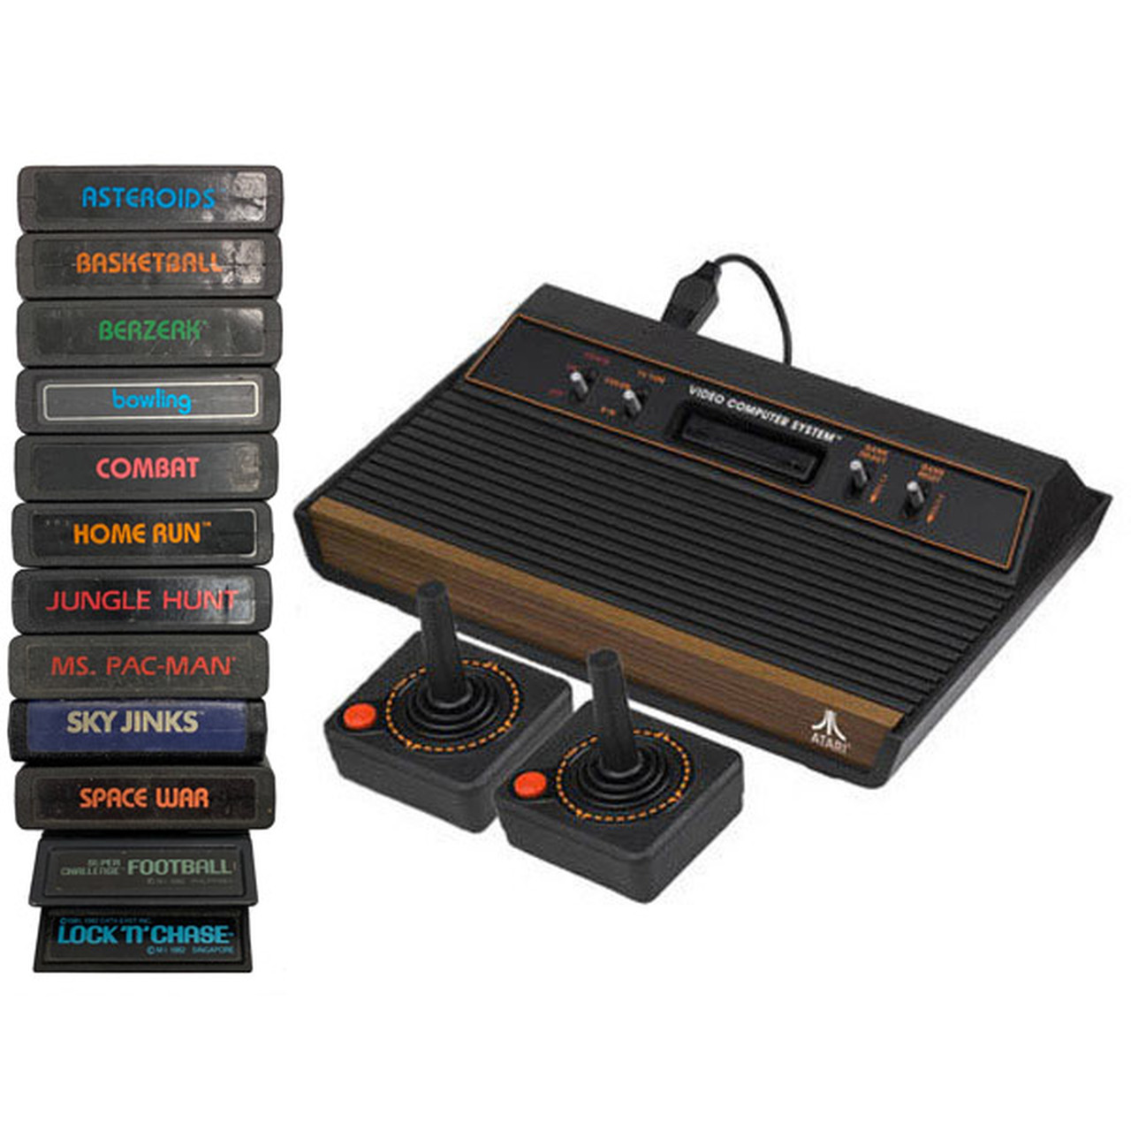
Atari 2600 (6502 processor)
Assembly Programming

Slide 2
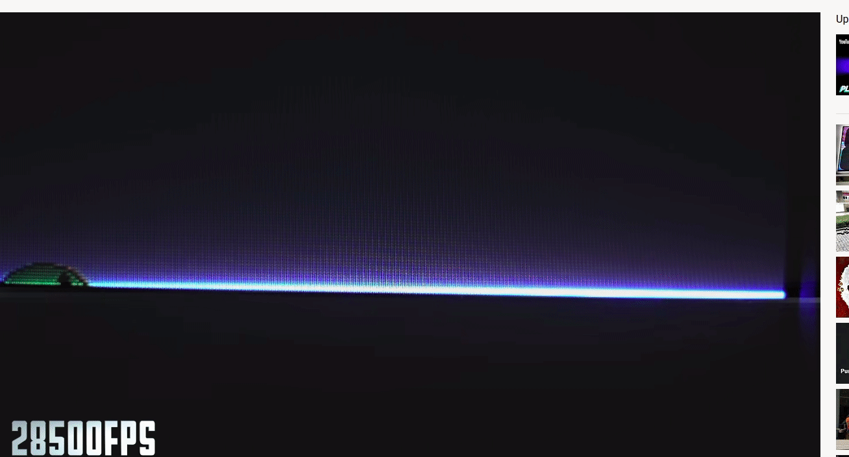
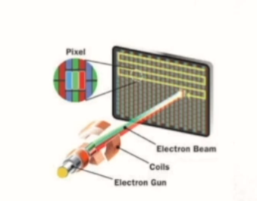
Displaying images on a CRT TV - Painting the screen
A CRT TV paints an image by shooting an electron gun at the screen in horizontal ‘scanlines’. A 1280x720 CRT (they exist and I want one) would have 720 visible scanlines.

Slide 3
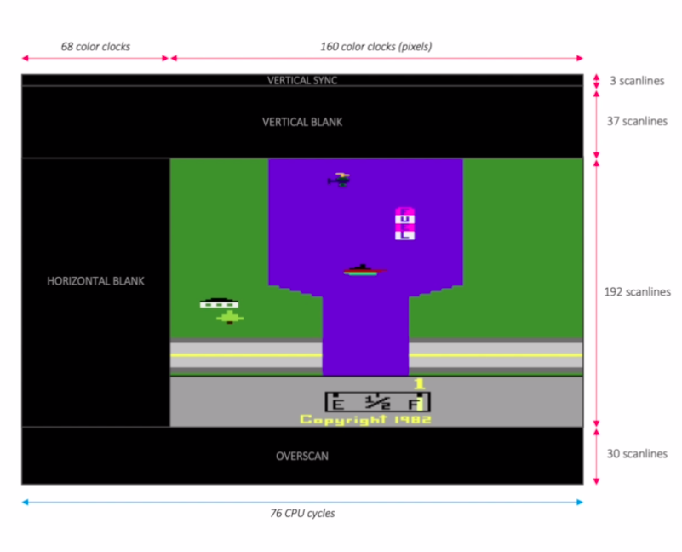
Racing the beam
The Atari 2600 will always paint 192 visible scanlines, with 160 pixels (color clocks) per scanline as it moves left to right.
However, it also has processing time available while the beam re-positions itself from right to left, or from bottom to top.
This time equates to:
After each scanline, the amount of time it would otherwise take to draw 68 pixels (the Horizontal Blank).
70 full scanline-times after all scanlines have been painted (i.e. after one whole frame). Programmers call these 70 the Vertical Blank and Overscan, and the Atari hardware abstracts them as happening ‘before’ and ‘after’ a frame.

Slide 4
Racing the beam
The Atari does not have enough memory to render frame-by-frame (i.e. it can’t hold the values of 192x160 = 30720 pixels in memory all at once), so it renders scanline-by-scanline.
This means the main game ‘loop’ runs for each scanline. The programmer’s main concern is their central ‘gameVisibleScanline()’ method, which needs to know when and where it should paint what object.
The VBLANK, HBLANK and OVERSCAN are important because they give the programmer time to run their commands and get a scanline ready before the beam begins firing.

Slide 5
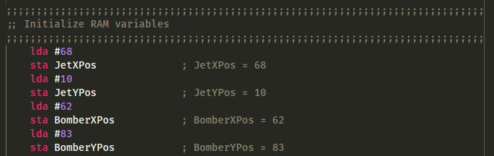
The assembly code
For anyone totally unfamiliar with assembly like I was, it looks scary but is obvious in hindsight. It’s just a set of instructions like any other language - the instructions are just limited to three characters each, so you have no hope of knowing what they do until you look at a reference sheet or someone tells you, unlike something like Python which is much more human-readable.
Assigning some variables initial values:

Slide 6
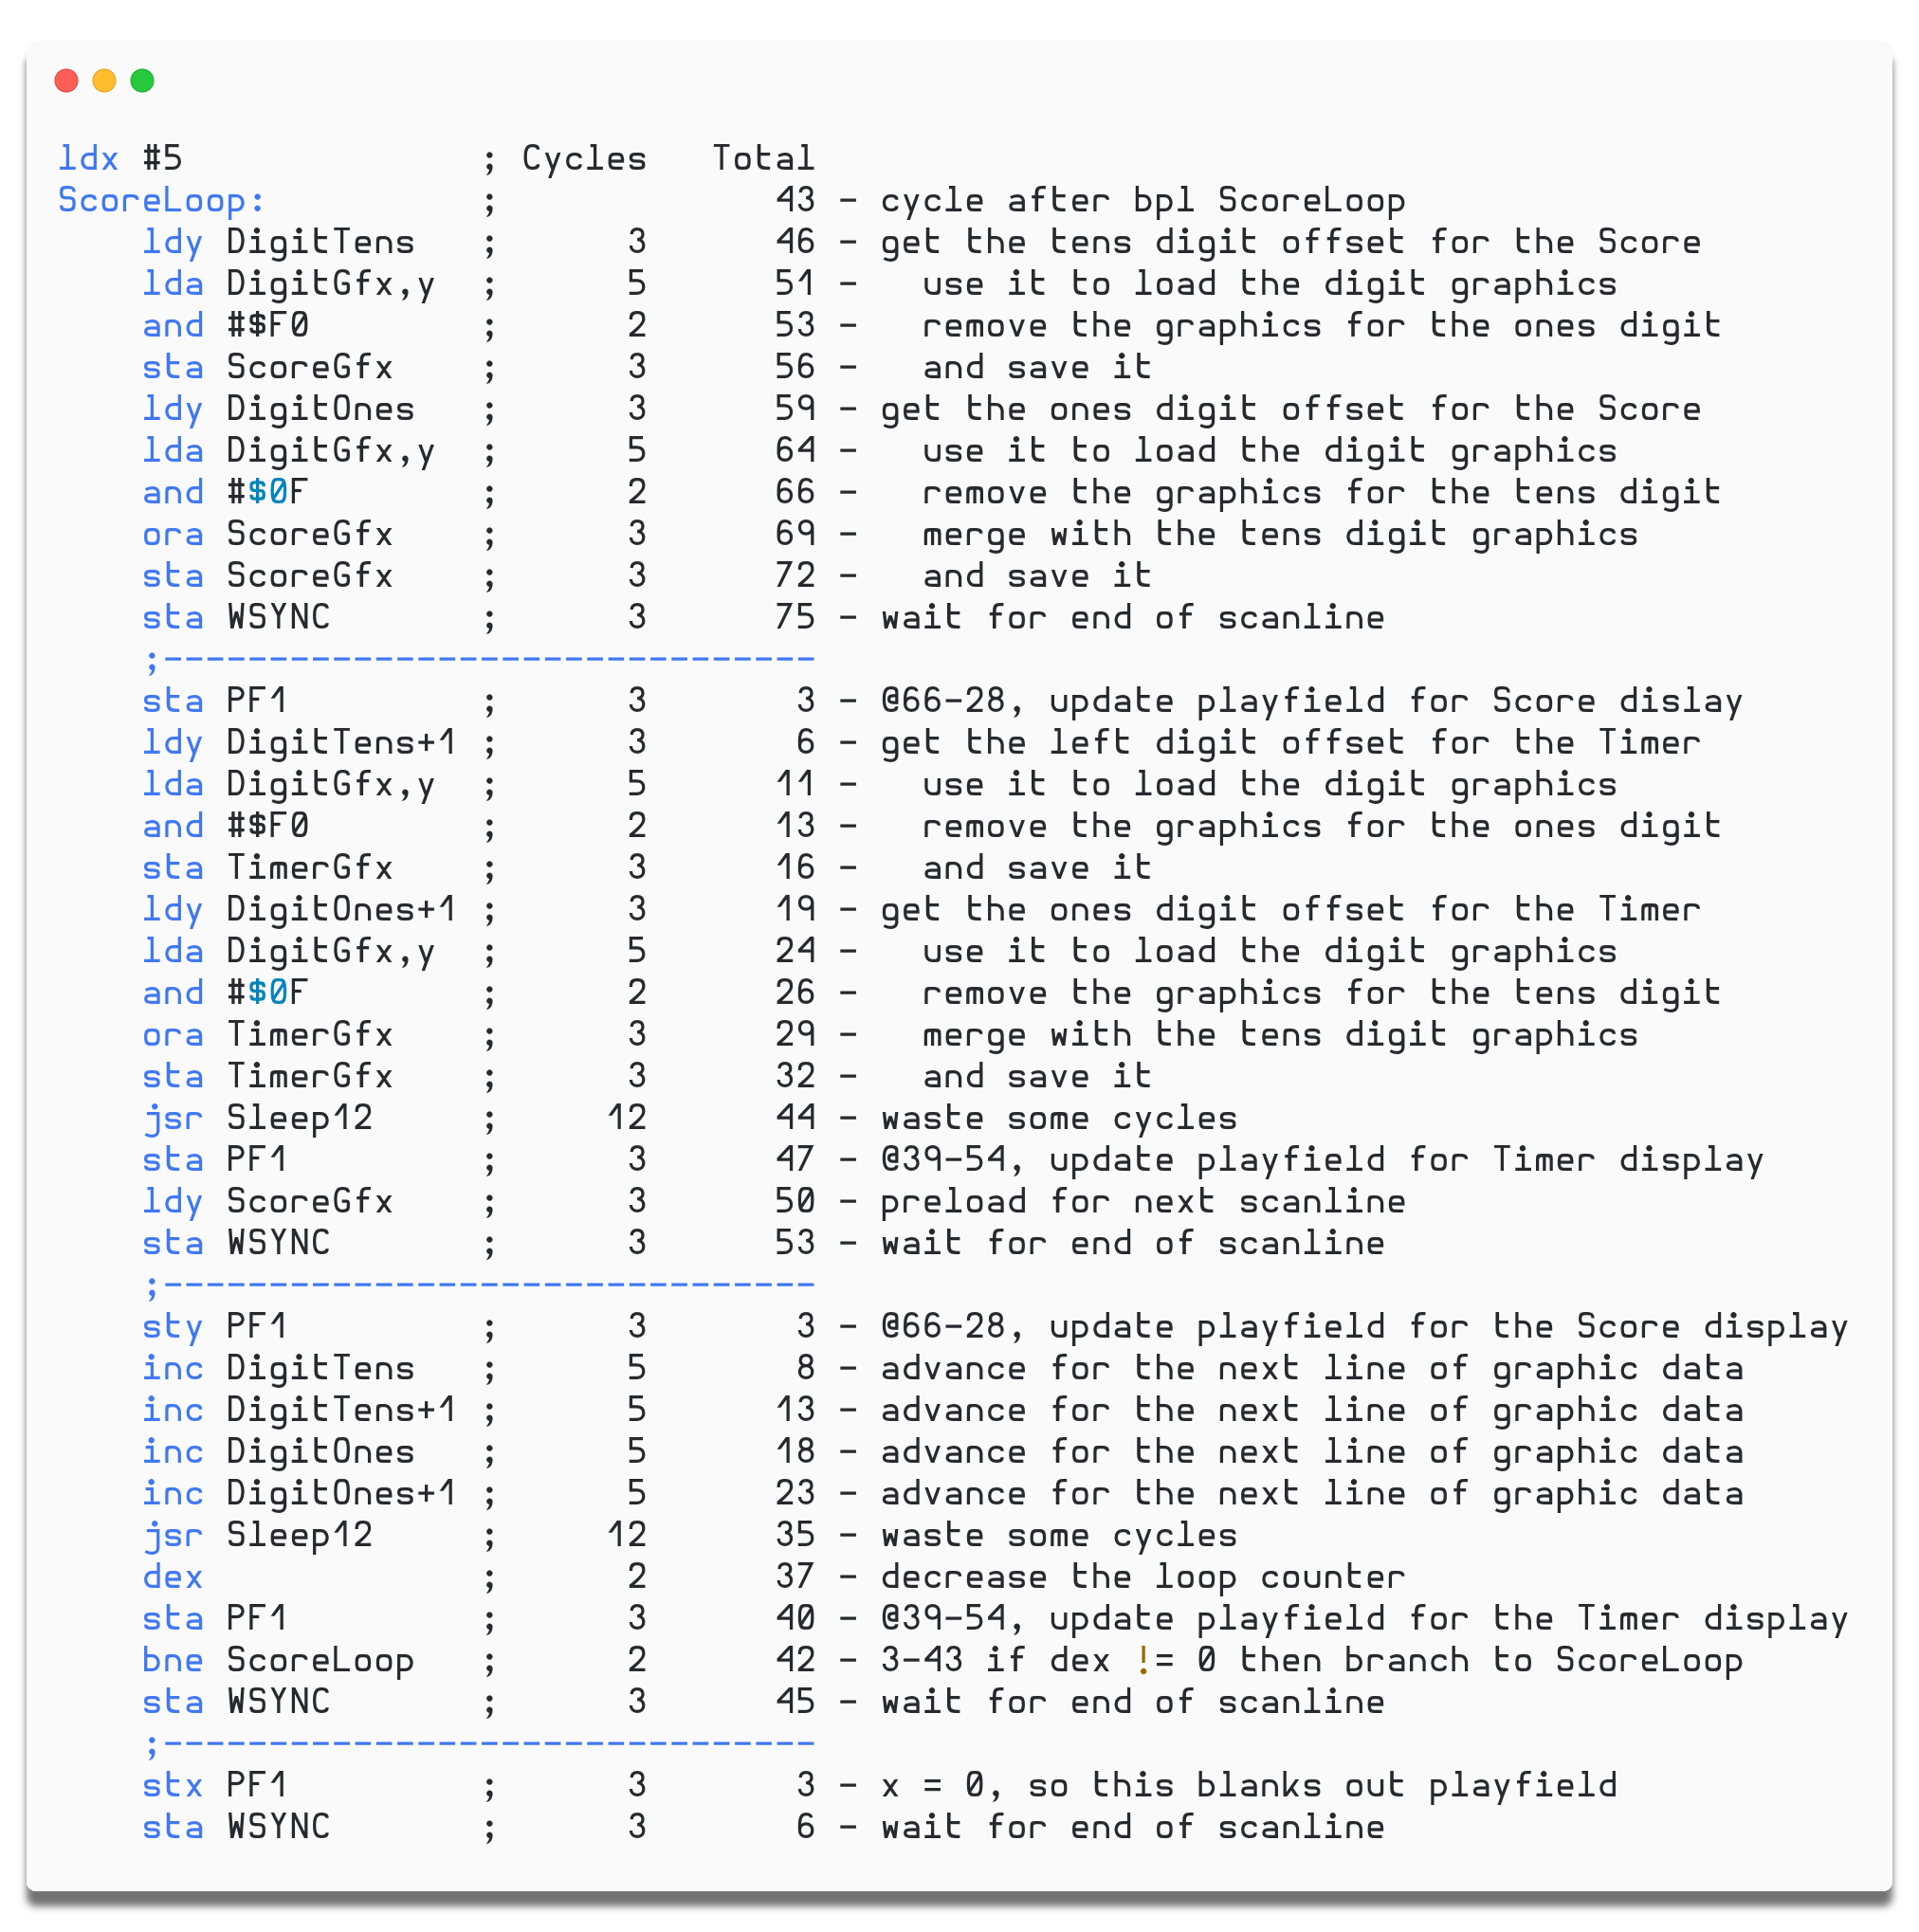
Racing the beam
Of course, clock cycles are limited, so we can’t perform a bunch of calculations before a scanline and expect the beam to wait for us. If you do perform too many instructions, the beam carries on with whatever instruction the Atari has gotten up to - you’ve ‘lost the race’, and you’ll have no idea where your code execution is up to at any given time.
As seen here, Atari programmers often leave comments on every single line of code for how many clock cycles a command takes, plus a running total, so they don’t run out of render time for each scanline.
For example, the given subroutine (function) Sleep12 wastes 12 clock cycles when called but has no code inside it, because a `jsr` command (jump to subroutine) takes 6 cycles, and an `rts` (return from subroutine) takes 6 as well.

Slide 7
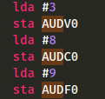
The assembly code
Because Atari games are so simple, there are dedicated registers for things like background color and player display.
This means, to set the background color, all that needs to be done is
There are other dedicated registers that are set to indicate things like:
“Player 1 should be displayed (somewhere) on this scanline”.
“Player 1’’s color is (accumulator value)”.
“A sound of volume 3 should be played until another sound command is executed.”
This makes Atari programming incredibly forgiving in a lot of ways compared to modern games (even though you have to learn 6502 assembly), because the Atari already has the abstractions of ‘player 1’ or ‘background’ or ‘audio’ built into its hardware, and has some idea of what the software is expecting to be able to do with them.

Slide 8
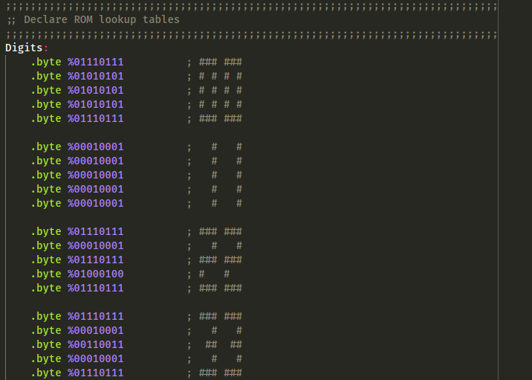
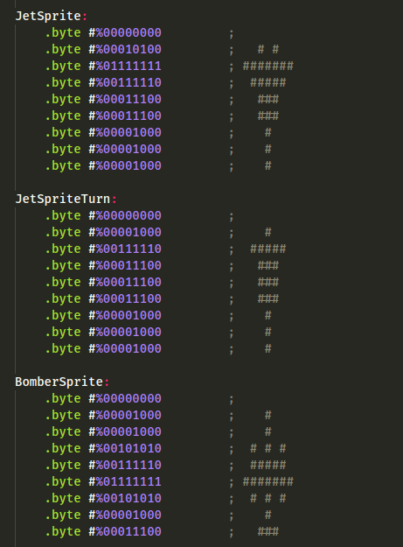
The assembly code
Every frame of animation has to be manually declared, stored and retrieved from memory, as binary pixel patterns, even numbers for a scoreboard! Usually done right at the end of the ROM (bottom of the code). No procedural generation here.

Slide 9
The final game!
https://drive.google.com/file/d/1dqYiU0lNIYODVJDQ8-Yk6RjZomaBA2HN/view?usp=sharing
https:/ /javatari.org/

